Slide 1

ReadMe
Book Price Prediction
By: Batoul Alosaimi ,Norah Alqahtani and Shroaq Almutairi

Slide 2
Methodology
1
Problem Understanding
2
Gather Data
3
Pre processing
4
EDA
5
Regression Model

Slide 3
Data Source :
1-kaggle(CSV file ) GoodReads dataset , 11128 books with 11 features .

Slide 4
Book dataset :
- 1298 books 12 features.

Slide 5

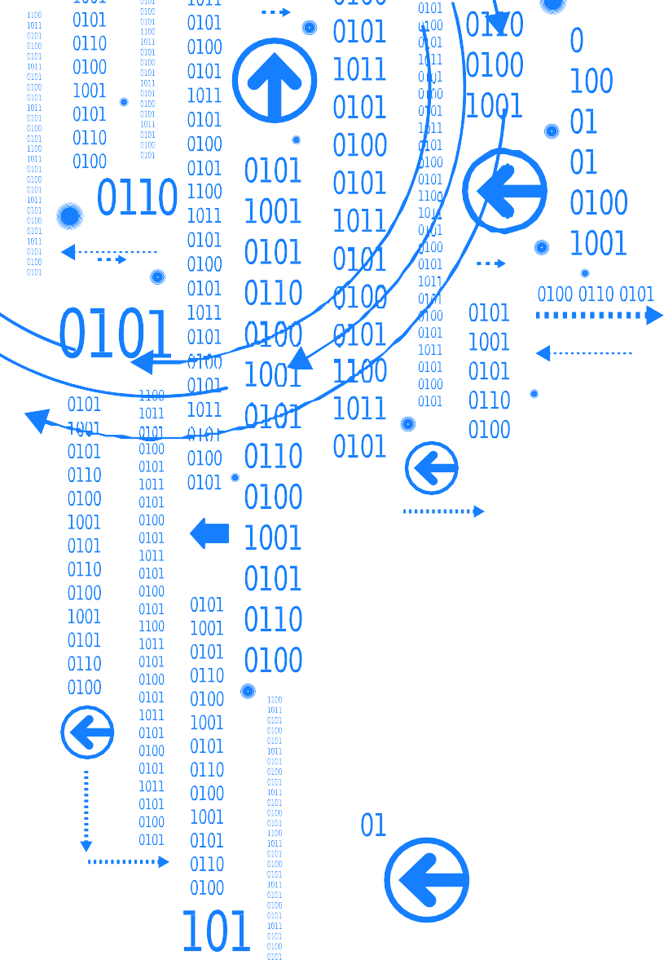





Preprocessing

Slide 6


Pre processing:
Removing nulls value.
Removing Duplicates.
Clean Price column

Slide 7
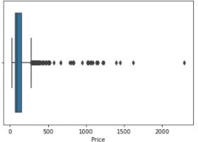
Pre processing:
Removing outlier in the price

Slide 8

Exploratory Data Analysis

Slide 9
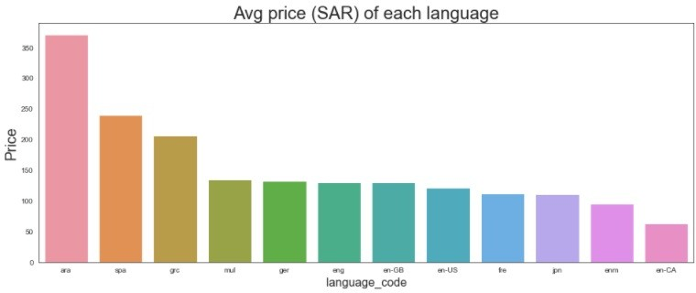
EDA:
Avg price (SAR) of each language

Slide 10
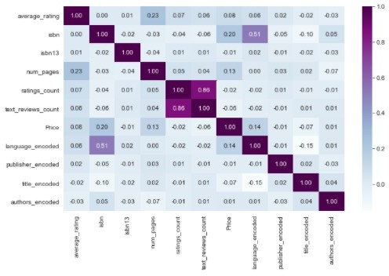
EDA:
correlation between feature:

Slide 11
Modeling

Slide 12
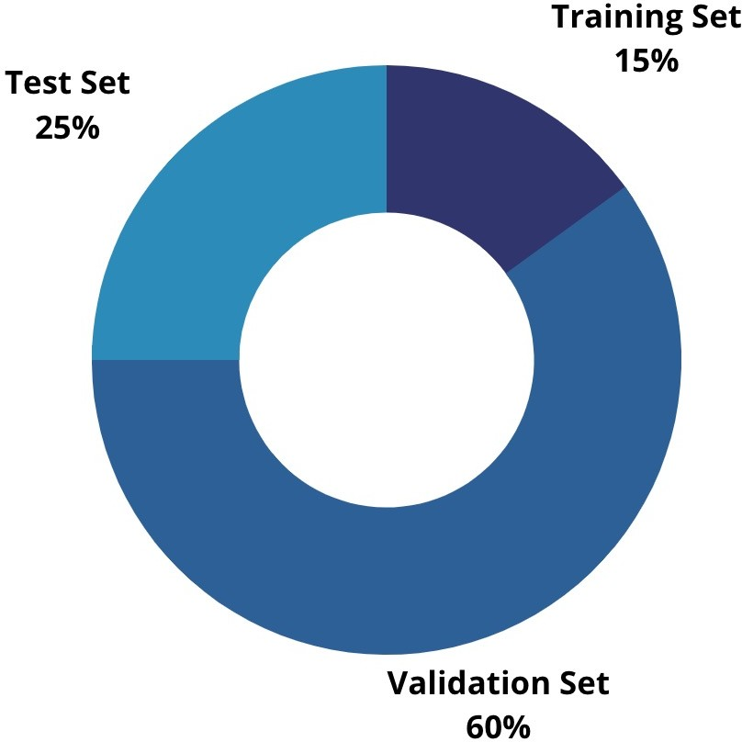
Splitting the data to Test (25%) and Train- Validation (75%) sets

Slide 13
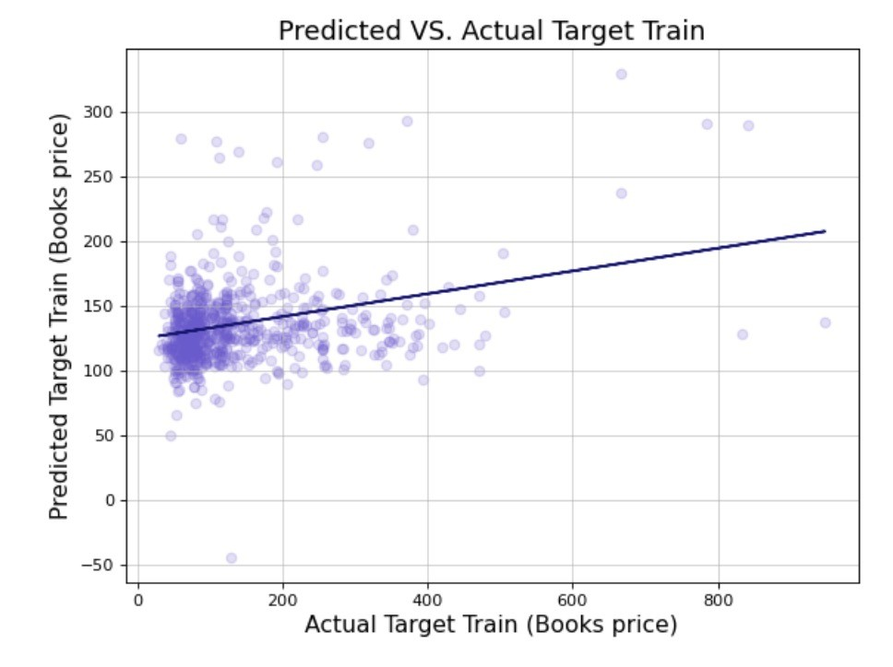

Modeling :

Slide 14
Cross Validation
Regression Algorithm | Linear Regression | Ridge Regression | Polynomial Regression (degree = 2) | Lasso Regression
Training Score | 0.075843 | 0.044664 | 0.068357 | 0.066383
Validation Score
0.029533
0.00066
0.006979 0.002216

Slide 15


Modeling After feature Engineering :
Linear Regression Score Result:
R^2 = 0.119

Slide 16
Conclusion & future work :
1. Data obtained via scraping websites are not reliable enough to validate a model's performance.
2. In future work we will co more effort to obtain more related features to reduce Bias

Slide 17
Thank you

